Slide 1
Data Manipulation Instructions
Arithmetic Instructions
  Increment and Decrement
    These are single-operand instructions. Operation:
        inc r/m ; r/m ← r/m + 1
        dec r/m ; r/m ← r/m − 1
    appropriate flags are set according to the result.
    The r operand specifies any of either an 8-bit, a 16-bit, or a 32-bit register.
    The m operand specifies a byte, or a word, or a double word size operand accessed from memory directly or indirectly
    Example: inc word [bx] increments the word-content at the location specified in bx.
    Example: dec byte [count] decrements the byte at the address associated with the label count.
Prof. Virender Kumar Ranga

Slide 2
  Negate
    This instruction returns the two’s complement of the original contents of its single explicit operand:
neg r/m ; r/m ← (r/m)’ + 1
    The operand size can be an 8-bit, a 16-bit, or a 32-bit value in a register r or a memory reference m.
    Example: neg dword [sum] will result in the two’s complement of the value stored at sum.
  Addition and Subtraction
    The add and sub instructions perform integer addition and subtraction, respectively:
      add r/m, r/m/k ; r/m ← r/m + r/m/k
      sub r/m/, r/m/k ;r/m ← r/m − r/m/k
    The registers (r) or memory locations (m) specified contain 8-bit, 16-bit or 32-bit operands.
    The zero (ZF) and the sign (SF) flags are set according to the results of the operation.
Prof. Virender Kumar Ranga

Slide 3
    Example: The addition of 42 + 87 = 129. If 8 bits are available to hold the result then 129 > 2⁷ − 1 = 127 indicates an overflow:
        0 0 1 0 1 0 1 0
        + 0 1 0 1 0 1 1 1
        1 0 0 0 0 0 0 1 = −(127)
    Consider also the addition of negative numbers: (−42 − 87 = −129). Note again that −129 < −2⁷ = −128 which indicates the occurrence of an overflow. In binary format:
        1 1 0 1 0 1 1 0
        + 1 0 1 0 1 0 0 1
        0 1 1 1 1 1 1 1 = +(127)
    Observe that when adding two numbers with the same sign, overflow occurs if the sign of the result is different.
    add and sub will also set the carry flag (CF) if an overflow occurs. Unlike the overflow flag, the carry flag is checked only for unsigned operations. Example:
        mov ax, 00FFh
        add al, 1
Prof. Virender Kumar Ranga

Slide 4
    the carry flag CF = 1; the result in ax is zero because the unsigned 8-bit addition is performed only on the al register. Contrast, however, with the following code:
        mov ax, 00FFh
        add ax, 1
    carries out a 16-bit addition with a result in ax of 0100h with no overflow and the carry remains equal to zero.
  Multiplication and Division
    Multiplication and division instructions take a single operand to specify a multiplier or a divisor.
    an additional implicit operand, multiplicand or dividend must be preloaded in the appropriate registers.
    two different formats: signed and unsigned for multiplication and division:
    Unsigned operations:
      mul reg/mem ; product ← r/m × al/ax/eax
      div reg/mem ; remainder:quotient ← al/ax/eax ÷ r/m
    Signed operations:
      imul reg/mem ; product ← reg/mem × al/ax/eax
      idiv reg/mem ; remainder:quotient ← al/ax/eax ÷ reg/mem
Prof. Virender Kumar Ranga

Slide 5
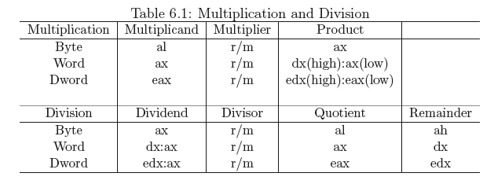
  Sign Extension. As shown in table 6.1, a multiplier and a multiplicand are n bits, then the product will require 2n bits. In the case of division, the dividend is 2n bits wide and the quotient and remainder require
  n bits.
  If the flow of computation renders and n-bit dividend then for sign division operations it must be sign-extended to 2n bits.
  In the following sign-extensions instructions the notation s_{x} indicates the sign bit repeated x times for the only purpose of describing the operation using a register transfer notation:
Prof. Virender Kumar Ranga

Slide 6
    cbw ; ax ← s₈:al
    ;converts the signed byte in al to a word in ax
    cwd ; dx:ax ← s₁₆:ax
      ; converts the signed word in ax to a double word in dx:ax
    cwde ; eax ← s₁₆:ax
    ;converts the signed word in ax into eax
    cdq ; edx:eax ← s₃₂:eax
    ;converts the signed double word in eax into edx:eax
    Example 1: The following code implements an 8-bit signed multiplication:
        mov al, -4 ;al = 1111 1100
        mov bl, 8
        imul bl ;ax = 1111 1111 1110 0000 = -32
    Example 2: The following code illustrates the implementation of a 16-bit multiplication:
        mov ax, 2000h ;ax = 0010 0000 0000 0000
        mov bx, 0025h
        mul bx ;dx:ax = 0000 0000 0000 0100:1010 0000 0000 0000
        ; = 0004h:A000h
Prof. Virender Kumar Ranga

Slide 7
    Example 3: A 32-bit multiplication:
      mov eax, 12345678h
      mov ebx, 100000h
      mul ebx ;edx:eax = 0001 2345h:6780 0000h
    Example 4: An 8-bit signed division. Suppose al = −48 then a sign-extension is required before the division is performed:
      cbw ;ax = FFD0h
      mov bl, 8
      div bl ;ax = 0000 0000 1111 1010
      ;al = quotient = -6; ah = remainder = 0
    Divide Overflow. If the result of a division is too large for the number of bits required by the operation, then a divide overflow occurs. The smaller the divisor is the larger the quotient and the more likely to trigger an overflow. When an overflow occurs a typical solution is to break an n-bit division into two n/2 operations.
Prof. Virender Kumar Ranga

Slide 8
    Example 1: This example illustrates the implementation of a 16-bit division where the quotient clearly requires 32 bits.
      segment data
        dividend dd 08010020h
        divisor dw 10h
      segment bss
        quotient resd 1
        remainder resw 1
      segment code
        ...
        ...
        mov ax, word [dividend+2] ;high part
        cwd ;extend sign
        mov cx, word [divisor]
        idiv cx ;ax=q (high), dx=r (high)
        mov bx,ax ;save q
        mov ax, word [dividend] ;low part, now dx:ax = dividend
        ;dx contains the remainder part
        idiv cx ;ax=q (low), dx=r (low)
        mov word [quotient], ax ;save quotient (bx:ax)
        mov word [quotient+2], bx
        mov word [remainder], dx ; save remainder
        ...
Prof. Virender Kumar Ranga

Slide 9
    Example 2: While overflow is a potential problem for any n-bit division, the 16-bit implementation in the previous example is contrasted with the following 32-bit code:
      segment .data
        dividend dd 08010020h
        divisor dd 10h
      segment .bss
        quotient resd 1
        remainder resd 1
      segment .code
        ...
        mov eax, dword [dividend]
        cdq
        mov ecx, dword [divisor]
        idiv ecx
        mov dword [quotient], eax
        mov dword [remainder], edx
        ...
Prof. Virender Kumar Ranga

Slide 10
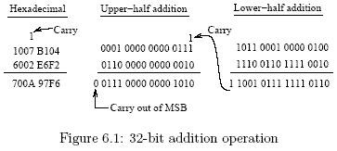
  Multiple addition and subtraction
    The next two instructions expand multiple add/sub operations to also add/sub the current state of the carry flag:
      adc r/m, r/m/k ; r/m ← r/m + r/m/k + CF
      sbb r/m, r/m/k ; r/m ← r/m − r/m/k − CF
    An illustration of how the carry affects multiple addition is shown in the 32-bit addition in Fig. 6.1.
Prof. Virender Kumar Ranga

Slide 11
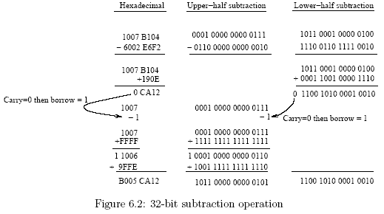
    The 32-bit subtraction operation in Fig. 6.2 illustrates the effect of a borrow bit:
Prof. Virender Kumar Ranga

Slide 12
    Example: Implement x = ax + c assuming a and c are signed word-size variables.
      segment data
        x dd 1250
        a dw 2
        c dw 1000
      segment code
        ...
        mov ax, data
        mov ds, ax
        mov ax, word [x]
        imul word [a] ;dx:ax = [a]*[x]
        clc ;reset carry flag
        add ax, word [c] ;ax = ax + [c]
        adc dx, 0 ;dx:ax = [a]*[x] + [c] + carry
        mov word [x], ax ;store result: low part
        mov word [x+2], dx ;high part
        ...
Prof. Virender Kumar Ranga

Slide 13

Shift Instructions
  Logical shifts
    A logical shift is the simplest type of shift. For each bit shifted there is an incoming bit equal to zero as shown in Fig. 6.3. The shl and shr instructions perform logical left and right shifts respectively.
    The number of bit positions to shift is a constant specified in the instruction or preloaded in the cl register.
    The last bit shifted out of the data is stored in the carry flag.
    The format and operation of these shift instructions are as follows (msg referes to the most significant bit position):
      shl r/m, k ; CF ← r/m(msb − k + 1)
      ;r/m(msb, … , k) ← r/m(msb − k, … , 0)
      ;r/m(k-1, … , 0) ← 0
      shl r/m, cl ; the shifting factor k is preloaded into cl
      shr r/m, k ; CF ← r/m(k − 1)
      ; r/m(msb − k, … , 0) ← r/m(msb, … , k)
      ; r/m(msb, … , msb-k+1) ← 0
      shr r/m, cl ; the shifting factor k is in cl
Prof. Virender Kumar Ranga

Slide 14
    The source operand k refers to an 8-bit constant. This operand can only be 1 for the 8086/8088 processors.
    The notation r/m(＊) refers to the contents of a register or a memory reference; the arguments within parenthesis indicate the bit positions accessed during the transfer.
    The operand k, or a preloaded cl register, provides the number of shifts executed.
    In general k shifts to the left are equivalent to multiplying data by 2^{k} and k is the shifting factor.
    Given a shifting factor of k, a dividend is shifted k bit positions to the right resulting in a division by 2^{k}.
    A typical use of logical shifts is to multiply or divide unsigned values. Shift instructions are very basic and are much faster than the corresponding mul and div instructions.
    An alternate short notation for shifting operations is exemplified as follows:
        shl eax, k ; eax ← 2^{k} × [eax]
        shr eax, k ; eax ← 2^{−k} × [eax]
Prof. Virender Kumar Ranga

Slide 15
    Examples
    1. Consider the use of left shift operations to implement 2 × 2⁵ :
        mov al, 2 ;al = 0000 0010
        mov cl, 5 ;shifting factor
        shl al, cl ;al = 0100 0000 = 2⁶ = 64
    Note that an 8-bit precision is assumed; however, to anticipate a 2n-bit product, an 8-bit multiplication requires a 16-bit result for which ax is used in place of al.
    2. Consider the operation 64/2⁵ using right shift operations:
        mov ax, 64 ;ax = 0000 0000 0100 0000
        mov cl, 5 ;shifting factor
        shr ax, cl ;ax = 0000 0000 0000 0010
    3. Consider the implementation of:
        O= 160r + 2c + 4096p
    where O is the offset in video memory that corresponds to the coordinates (r,c) in the screen displaying the contents of page p in real mode.
Prof. Virender Kumar Ranga

Slide 16
    IA 32-bit processors (386 and up) support double precision shifts using shld and shrd instructions:
        shld r/m, r, k ; CF ← r/m(msb - k + 1)
        ; r/m(msb, . . . , k) ← r/m(msb - k+1, . . . , 0)
        ; r/m(k -1, . . . , 0) ← r(msb, . . . ,msb - k + 1)
        shld r/m, r, cl ; cl is preloaded with k
        shrd r/m, r, k ; CF ← r/m(k -1)
        ; r/m(msb - k, . . . , 0) ← r/m(msb, . . . ,msb - k + 1)
        ; r/m(msb, . . . ,msb - k + 1) ← r(k -1, . . . , 0)
        shrd r/m, r, cl ; cl is preloaded with k
    As shown in Fig. 6.4 shld places its second operand to the right of its first, then shifts the entire bit string thus generated to the left by k bits specified in the third operand. It then updates only the first operand according to the result of the shifts.
    The second operand is always a register and its contents are not modified.
    Shrd performs the corresponding right shift by placing the second operand to the left of the first, shifts the whole bit string right, and updates only the first operand.
    For every shift the bit shifted out is moved into the carry flag.
Prof. Virender Kumar Ranga

Slide 17
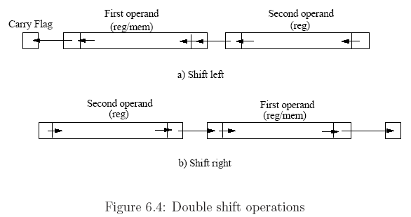
Examples:
1. The instruction shfrd ax,bx,10 logically shifts ax right by 10 bit positions. The right most 10 bits of bx are right shifted into the leftmost bits of ax. The contents of bx remain unmodified. In terms of bit operations the following events take place:
      CF ← ax(9)
      ax(15, . . . , 10) ← ax(5, . . . , 0)
      (c) ax(9, . . . , 0) ← bx(15, . . . , 9)
2. Suppose eax holds the value 01234567h, and ebx holds the value 89ABCDEFh, then the execution of shld eax, ebx, 8 will update eax to a value 23456789h, and the carry flag will be equal to 1. If the instruction shrd eax, ebx, 8 is executed instead then the new contents of eax will be EF012345h, and the carry flag will be 0. The contents of ebx are not changed in neither case.
Prof. Virender Kumar Ranga

Slide 18
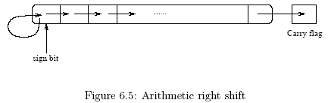
  Arithmetic shifts
    These shifts are designed for signed values to be quickly multiplied or divided by powers of 2. They insure that the sign bit is treated correctly.
        sal r/m, k ; similar to shl
        sal r/m, cl ; similar to shl
        sar r/m, k ; CF ← r/m(k - 1)
        ; r/m(msb - k, . . . , 0) ← r/m(msb, … , k)
        ; r/m(msb, . . . ,msb - k + 1) ← r/m(msb)
        sar r/m, cl ; cl is preloaded with k
    The sal (shift arithmetic left) is functionally identical to shl.
    For each shift the most significant bit is shifted into the carry flag.
    The sar (shift arithmetic right) instruction does not change the most significant bit (the sign bit) but for each shift a copy is transferred to the next bit on the right. All other bits are shifted to the right.
    The least significant bit is shifted into the carry flag as shown in Fig. 6.5
Prof. Virender Kumar Ranga

Slide 19
  Example: The following sequence of operations illustrate an arithmetic right shift with a shifting factor k = 3:
      mov ax, 0A004h ; ax = 1010 0000 0000 0100
      mov cl, 3
      sar ax, cl ; ax = 1111 0100 0000 0000, and C = 1
  The bit-level operations can be described in the following steps:
      1. CF = ax(2) = 1,
      2. ax(12,...,0) ← ax(15,...,3),
      3. ax(15,..,13) ← ax(15) = 1.
Prof. Virender Kumar Ranga

Slide 20
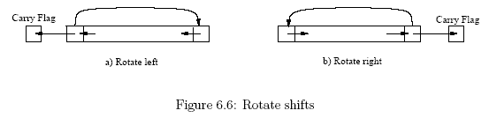
  Rotate Instructions
    The rotate shift instructions treat data as if it is a circular structure. The bit that is shifted out on one end is shifted in on the other side. Each bit shifted around is also copied into the carry flag as shown in Fig. 6.6:
        rol r/m, k ; CF ← r/m(msb - k + 1)
        ; r/m(k . 1, . . . , 0) ← r/m(msb, . . . ,msb - k + 1)
        ; r/m(msb, . . . , k) ← r/m(msb - k, . . . , 0)
        rol r/m, cl ; cl is preloaded with k
        ror r/m, k ; CF ← r/m(k - 1)
        ; r/m(msb, . . . ,msb - k + 1) ← r/m(k - 1, . . . , 0)
        ; r/m(msb - k, 0) ← r/m(msb, · · · , k)
        ror r/m, cl ; cl is preloaded with k
Prof. Virender Kumar Ranga

Slide 21
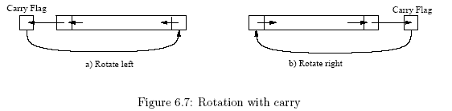
    Example: The following code segment shows the effects of applying ror twice:
        mov al, 01h ;al = 0000 0001
        ror al, 1 ;al = 1000 0000, CF = 1
        ror al, 1 ;al = 0100 0000, CF = 0
    There are two additional rotate instructions, rcl and rcr that rotate data bits and the carry flag to the left, and to the right, respectively. For example, if the contents of the ax register are rotated with these instructions, the 17-bits made up of ax and the carry flag are rotated. Rotation with carry is illustrated in Fig. 6.7.
Prof. Virender Kumar Ranga

Slide 22
Boolean Instructions
  The AND instruction
    performs a bitwise logical AND operation between its two operands and stores the result in the destination operand:
        and r/m, r/m/k ; r/m ← r/m ∧ r/m/k
    The destination operand can be a register or a memory reference. The source operand can be a register, a memory reference, or an immediate value (k).
    A typical use of this instruction is to use bit masking to clear or reset selected bits.
    Example: Use a bit mask = 0000 1111 to clear the four most significant bits in register al:
        mov al, 0011 1011b
        and al, 0000 1111b ;al = 0000 1011
  The OR instruction
    The OR instruction executes the logical OR operation on its two operands. The format and operation description follow:
Prof. Virender Kumar Ranga

Slide 23
or r/m, r/m/k ; r/m ← r/m ∨ r/m/k
    Typical uses of the or instruction include setting selected bits, and ORing an operand with itself to set flags.
    Example: With the use of a bit mask set the most significant bits in register al:
        mov al, 0011 1011b
        or al, 1111 0000b ;al = 1111 1011
  The NOT instruction
    The NOT instruction is a unary operation that returns the one’s complements of the value in its single operand. No flag bit is affected.
    not r/m ; r/m ← (r/m)’
  The XOR instruction
    The format of the XOR and the description of its register-level operation are:
    xor r/m, r/m/k ; r/m ← r/m. r/m/k
    A typical use of the XOR instruction is to toggle one or more selected bits.
    Example: Toggle the first two least significant bits on the contents of the register al:
        mov al, 0011 1010b
        xor al, 0000 0011b ;al = 0011 1001
Prof. Virender Kumar Ranga

Slide 24
  The TEST Instruction
    The test instruction performs an AND operation, but does not store the result. It only sets the flags register based on what the result would be.
    test is to logical operations what the cmp instructions is to arithmetic operations.
    The results do not alter the contents of the destination operand.
    The format and operation are described as follows:
    test r/m, r/m/k ; result = r/m ∧ r/m/k
    Example: Set flags to inspect the nature of the value stored in al:
        mov al, 0010, 0101b
        test al, 0000 10001b ;result = 0000 0001, Z = 0
    The results of the test indicate that the contents of al correspond to a positive value.
Prof. Virender Kumar Ranga

